Slide 1

CS 214 Object Oriented Programming
Department of Computer Science and Engineering

Slide 2
Operator Overloading
and
Inheritance

Slide 3
Contents
Concept of operator overloading
Overloading unary and binary operators
Prefix and postfix operator implementation
Introduction to Inheritance,
Base and derived classes
Member access control
Types of inheritance
Inheriting constructors and destructors
Overriding member functions
Ambiguity in multiple inheritance
Virtual base class

Slide 4
Introduction to Operator Overloading
An operator overloading is a feature in C++ programming that allows programmer to redefine the meaning of an existing operator when they operate on class objects.
It is the ability to tell the compiler how to perform a certain operation when its corresponding operator is used on one or more variables.
Closely related to function overloading.
Allows existing operators to be redefined (overloaded) to have new meaning for a specific class objects.
Already used the + and - in overloaded fashion when add or subtract ints, floats, doubles, etc.

Slide 5
Introduction to Operator Overloading
Overloading of operators are achieved by creating operator function
An operator function defines the operations that the overloaded operator can perform relative to the class
An operator function is created using the keyword operator
Operator functions can be either members or nonmembers of a class
Non-member operator functions are always friend functions of the class

Slide 6
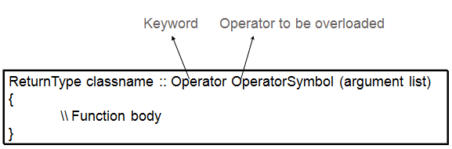
Syntax of Operator Overloading
Overloading an operator
Write function definition as normal
Function name is keyword operator followed by the symbol for the operator being overloaded
operator+ used to overload the addition operator (+)
General form of an operator function
Example
void space :: operator - ()
{
x= -x;
y= -y;
}

Slide 7
Syntax of Operator Overloading
class complex { double real, imag;
public: complex(double r, double i): real(r), imag(i) {} //constructor complex operator+(complex); //complex number addition complex operator*(complex); //complex number multiplication complex& operator=(complex); ...
};

Slide 8
Restrictions on Operator Overloading
Precedence or associativity of an operator cannot be changed by overloading
Use parentheses to force order of overloaded operators in an expression
C++ does not allow new operators (the symbols themselves) to be created
Number of operands an operator takes cannot be changed
Unary operators remain unary, and binary operators remain binary
Cannot overload the meaning of operators if all arguments are primitive data types
i.e. No overloading operators for built-in types
Cannot change how two integers are added
Operators that cannot be overloaded
:: | scope resolution operator
. | direct member access operator
.* | direct pointer to member access operator
sizeof | size of object operator

Slide 9
Overloading Unary Operators
C++ operators are classified as unary or binary, depending on whether they take one or two arguments, respectively
One can overload an operator by making it a function
Subsequently, one can use it just like any other function
Unary operators that can be overloaded

Slide 10
Overloading Unary Operators
A minus operator when used as a unary, takes just one operand
Unary minus changes the sign of an operand when applied to a basic data item
Unary minus when applied to an object should change the sign of each of its data items
class space{
int x, y, z;
public:
void getdata(int a, int b, int c);
void display(void);
void operator-();
};
void space::getdata(int a, int b, int c)
{ x=a;
y=b;
z=c;
}
void space::display(void)
{
cout<<“x= “<<x<<” “;
cout<<“y=“<<y<<“ “;
cout<<“z=“<<z<<“\n”;
}
void space :: operator-()
{
x= -x;
y= -y;
z= -z;
}
int main()
{
space S;
S.getdata(10,-20,30);
cout<<“S: “;
S.display();
-S; //activates operator –()
cout<<“-S: “;
S.display();
return 0;
}

Slide 11
Overloading Binary Operators
Binary operators, overloaded through a member function, take one explicit argument
Those , which are overloaded through a friend function, take two explicit arguments
In overloading of binary operators, left-hand operand is used to invoke the operator function and the right-hand operand is passed as an argument

Slide 12
Binary operators that can be overloaded
Operator | Usual use | Associativity
* | Remainder (modulus) | Left to Right
+ | Addition | Left to Right
- | Subtraction | Left to Right
<< | Shift bits to left | Left to Right
>> | Shift bits to right | Left to Right
> | Greater than | Left to Right
< | Less than | Left to Right
>= | Greater than or equal to | Left to Right
<= | Less than or equal to | Left to Right
== | Equal to | Left to Right
!= | Not equal to | Left to Right
&& | Logical AND | Left to Right
|| | Logical OR | Left to Right
& | Bitwise AND | Left to Right
| | Bitwise inclusive OR | Left to Right
Operator | Usual use | Associativity
^ | Bitwise exclusive OR | Left to Right
= | Assignment | Right to Left
+= | Add and Assign | Right to Left
-= | Subtract and Assign | Right to Left
*= | Multiply and Assign | Right to Left
/= | Divide and Assign | Right to Left
%= | Modulus and Assign | Right to Left
&= | Bitwise AND and Assign | Right to Left
|= | Bitwise OR and Assign | Right to Left
<<= | Shift Left and Assign | Right to Left
>>= | Shift Right and Assign | Right to Left
-> | Member Pointer | Left to Right
new | Allocate Memory | Right to Left
delete | Deallocate Memory | Right to Left
() | Function Call | Left to Right

Slide 13
Example 1: Overloading Binary + Operator
class Rectangle{
int length, breadth;
public:
Rectangle(){ length=0; breadth=0; }
Rectangle(int l, int b)
{length= l; breadth= b;}
//Binary operator overloading function
Rectangle operator +(Rectangle rec)
{
Rectangle R;
R.length= length + rec.length;
R.breadth= breadth + rec.breadth;
return(R);
}
void display(void);
};
void Rectangle :: display(void)
{
cout<<“\n Length =”<<length;
cout<<“\n Breadth=”<<breadth;
}
int main()
{
Rectangle R1, R2, R3; //Creating Objects
R1 = Rectangle(2, 5);
R2 = Rectangle(3, 4);
R3 = R1 + R2; // R1 will invoke operator+()
// R2 is passing as argument
cout<<“\n Rectangle:1 “; R1.display();
cout<<“\n Rectangle:2 “; R2.display();
cout<<“\n Rectangle:3 “; R3.display();
return 0;
}
Output:
Rectangle:1
Length = 2
Breadth = 5
Rectangle:2
Length = 3
Breadth = 4
Rectangle:3
Length = 5
Breadth = 9

Slide 14
Example 2: Overloading Binary + Operator
void complex :: display(void)
{
cout<<x<<“ + j”<<y<<“\n”;
}
int main()
{
complex C1, C2, C3;
C1 = complex(2.5, 3.5);
C2 = complex(1.6, 2.7);
C3 = C1 + C2;
cout<<“C1 = “; C1.display();
cout<<“C2 = “; C2.display();
cout<<“C3 = “; C3.display();
return 0;
}
class complex{
float x; //real part
float y; //imaginary part
public:
complex() { }
complex(float real, float imag)
{x=real; y= imag;}
complex operator +(complex);
void display(void);
};
complex complex :: operator+(complex c)
{ complex temp;
temp.x= x + c.x;
temp.y= y + c.y;
return(temp);
}
Output:
C1 = 2.5 + j3.5
C2 = 1.6 + j2.7
C3 = 4.1 + j6.2

Slide 15
Prefix Operator Implementation
The ++ is used to increment variables, and -- to decrement variables
When a prefix operator such as ++ is used in an expression, the mathematical operation takes place before the expression is evaluated
Prefix ++ Increment Operator Overloading with no return type
int main()
{
Check obj;
obj.Display(); // Displays value of data member i for object obj
++obj; // Invokes operator function void operator ++( )
obj.Display(); // Displays the value of data member i for object obj
return 0;
}
Output: i=0
i=1
class Check
{
private:
int i;
public:
Check(): i(0)
{ }
void operator ++()
{ ++i;
}
void Display()
{ cout << "i=" << i << endl; }
};

Slide 16
Prefix Operator Implementation
Prefix Increment ++ Operator Overloading with return type
class Check
{
private:
int i;
public:
Check(): i(0)
{ }
Check operator ++() //return type is Check
{
Check temp;
++i;
temp.i = i;
return temp;
}
void Display()
{ cout << "i=" << i << endl; }
};
Output: i = 0
i = 0
i = 1
i = 1
int main()
{
Check obj, obj1;;
obj.Display();
obj1.Display();
obj1= ++obj;
obj.Display();
obj1.Display();
return 0;
}

Slide 17
Postfix Operator Implementation
Postfix Increment ++ Operator Overloading
class Check
{
private:
int i;
public:
Check(): i(0) { }
Check operator ++ ()
{
Check temp;
temp.i = ++i;
return temp;
}
// Notice int inside bracket which indicates postfix increment.
Check operator ++ (int)
{ Check temp;
temp.i = i++;
return temp;
}
void Display()
{ cout << "i = "<< i <<endl; } };
int main()
{
Check obj, obj1;
obj.Display();
obj1.Display();
// Operator function is called, only then value of obj is assigned to obj1
obj1 = ++obj;
obj.Display();
obj1.Display();
// Assigns value of obj to obj1, only then operator function is called.
obj1 = obj++;
obj.Display();
obj1.Display();
return 0;
}
Output:
i = 0 i = 0 i = 1 i = 1 i = 2 i = 1
When the postfix operator is used, the expression is evaluated before the mathematical operation takes place.

Slide 18
Postfix Operator Implementation
Operator Overloading of Decrement -- Operator
class Check
{
private:
int i;
public:
Check(): i(3) { }
Check operator -- ()
{
Check temp;
temp.i = --i;
return temp; }
// Notice int inside bracket which indicates postfix decrement.
Check operator -- (int)
{ Check temp;
temp.i = i--;
return temp;
}
void Display()
{ cout << "i = "<< i <<endl; } };
int main()
{
Check obj, obj1;
obj.Display();
obj1.Display();
// Operator function is called, only then value of obj is assigned to obj1
obj1 = --obj;
obj.Display();
obj1.Display();
// Assigns value of obj to obj1, only then operator function is called.
obj1 = obj--;
obj.Display();
obj1.Display();
return 0;
}
Output:
i = 3 i = 3 i = 2 i = 2 i = 1 i = 2

Slide 19
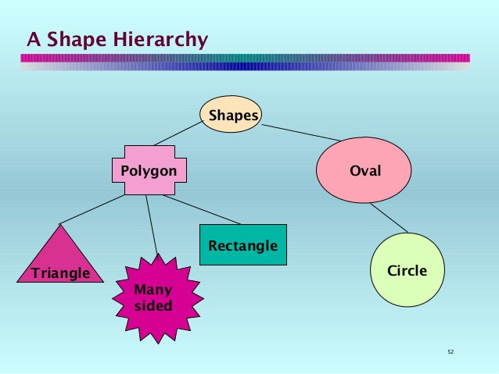
Introduction to Inheritance
It is the mechanism by which one class acquires the properties of another class
Provides a way to create a new class from an existing class
The new class is a specialized version of the existing class
Inheritance establishes an "is a" relationship / a parent-child relationship between classes
Allows sharing of the behavior of the parent class into its child classes
Child class can add new behavior or override existing behavior from parent
It allows a hierarchy of classes to be built, moving from the most general to the most specific
Example: Shape Taxonomy

Slide 20
Advantages of inheritance
Reusability:
reuse the methods and data of the existing class
Extendibility:
extend the existing class by adding new data and new methods
Modifiability:
modify the existing class by overloading its methods with newer implementations
Saves memory space and time
Increases reliability of the code
Saves the developing and testing efforts

Slide 21
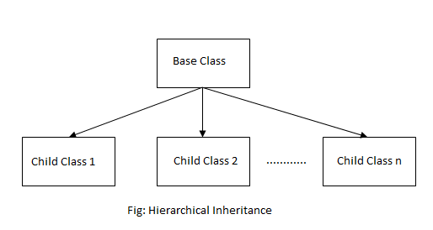
Inheritance terms
superclass, base class, parent class:
Describe the parent in the relationship, which shares its functionality
Defines all qualities common to any derived classes.
subclass, derived class, child class:
Describe the child in the relationship, which accepts functionality from its parent
Inherits those general properties and adds new properties that are specific to that class.
extend, inherit, derive:
become a subclass of another class

Slide 22
Class Derivation
Any class can serve as a base class…………Thus a derived class can also be a base class
Syntax
DerivedClassName - the class being derived
specification - specifies access to the base class members
public / protected / private - private by default
class DerivedClassName:: specification BaseClassName
Example:
class Employee // base class
{
. . .
};
class salariedEmployee : public Employee
{ // derived class
. . .
};
Employee
salariedEmployee

Slide 23
What Does a Child Have?
An object of the derived class has:
all members defined in child class
all members declared in parent class
An object of the derived class can use:
all public members defined in child class
all public members defined in parent class

Slide 24
Class Access Specifiers
public – object of derived class can be treated as object
of base class (not vice-versa)
e.g. class salariedEmployee : public Employee
2) protected – more restrictive than public, but allows
derived classes to know details of parents
e.g. class hourlyEmployee : protected Employee
3) private – prevents objects of derived class from being
treated as objects of base class
e.g. class weeklysalariedEmployee : private Employee

Slide 25
Access Specifiers
Less Restrictive
Class
Accessible from own class
Accessible from derived class
Accessible from class objects
Private Area
public
No entry to
Private area
Data
Functions
protected
Accessible from own class
Accessible from derived class
Public Area
Data
Entry allowed to
Public area
Functions
private
Accessible from own class
More Restrictive
* By default all items defined in the class are private

Slide 26
Example: Access Specifiers
Employee
Department
Manager
public:
string name;
protected:
string designation;
private:
int Age;
CommissionEmployee
SalariedEmployee

Slide 27
Member Access Control
Type 1: inherit as private
Type 2: inherit as protected
Base | Derived
private members | inaccessible
protected members | private members
public members | private members
Base | Derived
private members | inaccessible
protected members | protected members
public members | protected members
Type 3: inherit as public
Inheritance and Access Specifier
Base | Derived
private members | inaccessible
protected members | protected members
public members | public members
Access | public | Protected | Private
Members of the same class | Yes | Yes | Yes
Members of derived classes | Yes | Yes | No
Non-members | Yes | No | No

Slide 28
Inheritance vs. Access
How inherited base class members
appear in derived class
Base class members
private: x
protected: y
public: z
private
base class
x is inaccessible
private: y
private: z
private: x
protected: y
public: z
protected
base class
x is inaccessible
protected: y
protected: z
private: x
protected: y
public: z
public
base class
x is inaccessible
protected: y
public: z

Slide 29
Types of Inheritance
1. Single Inheritance:
It is the inheritance hierarchy wherein one derived class inherits from one base class.
2. Multiple Inheritance:
It is the inheritance hierarchy wherein one derived class inherits from multiple base class(es)
3. Hierarchical Inheritance:
It is the inheritance hierarchy wherein multiple subclasses inherits from one base class.
4. Multilevel Inheritance:
It is the inheritance hierarchy wherein subclass acts as a base class for other classes.
5. Hybrid Inheritance:
The inheritance hierarchy that reflects any legal combination of other four types of inheritance.

Slide 30
Single Inheritance
There is only one base class and has only one derived class.
class Employee // Employee superclass
{
. . . . .
};
class SalariedEmployee : public Employee // SalariedEmployee subclass inherits class Employee
{
private:
double weeklySalary;
public:
. . . .
};
Employee
salariedEmployee

Slide 31
Multiple Inheritance
One derived class with multiple base classes
Syntax
class DerivedClassName:: access BaseClassName-1, access BaseClassName-2, …….
class Employee // Employee superclass
{
private:
string firstName, string lastName;
public:
. . . . .
};
class Commission // Commission superclass
{
public:
void setCommissionRate(double rate)
{
commissionRate=(rate>0.0&&rate<1.0)?rate:0.0;
}
};
class CommissionEmployee : public Employee, public Commission
{
. . . . . // derived class definition
};
Employee
Commission
Commission Employee

Slide 32
Multilevel Inheritance
Subclass can be created from another intermediate subclass
class Employee // Employee superclass
{
private:
string firstName, string lastName;
public:
. . . . .
};
class Commission: public Employee // Commission Subclass
{
public:
void setCommissionRate(double rate)
{
commissionRate=(rate>0.0&&rate<1.0)?rate:0.0;
}
};
class SalariedCommissionEmployee : public Commission
{
. . . . . // derived class definition
};
Employee
Base Class
Commission
Intermediate
Base Class
SalariedCommission Employee
Derived Class

Slide 33
Hierarchical Inheritance
Employee
Base Class
Derived Classes
SalariedEmployee
HourlyEmployee
CommissionEmployee
Multiple subclasses have only one base class
class Employee // Employee superclass
{
private:
string firstName, string lastName;
public:
. . . . .
};
class SalariedEmployee : public Employee // Subclass
{
public:
void setWeeklySalary (double salary)
{
weeklySalary=salary<0.0?0.0:salary;
}
};
class HourlyEmployee : public Employee // Subclass
{ public:
void setHours(double hoursWorked)
{ . . . . . .
}
};
class CommissionEmployee: public Employee //Subclass
{
public:
void setCommissionRate(double rate)
{
commissionRate=(rate>0.0&&rate<1.0)?rate:0.0;
}
};

Slide 34
Hybrid Inheritance
Employee
SalariedEmployee
Commission
Any legal combination of other four types of inheritance
Payment
class Employee // Employee superclass
{
private:
string firstName, string lastName;
public:
. . . . .
};
class SalariedEmployee : public Employee
{
public:
void setWeeklySalary (double salary)
{
weeklySalary=salary<0.0?0.0:salary;
}
};
class Commission // Commission Subclass
{
public:
void setCommissionRate(double rate)
{
commissionRate=(rate>0.0&&rate<1.0)?rate:0.0;
}
};
class Payment : public SalariedEmployee, public Commission
{
double earnings()
{ . . . . . }
};

Slide 35
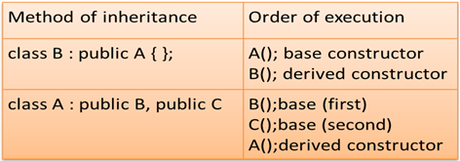
Constructors and Destructors in Base and Derived Classes
Derived classes can have their own constructors and destructors
When an object of a derived class is created, the base class’s constructor is executed first, followed by the derived class’s constructor
In case of multiple inheritances, the base classes are constructed in the order in which they appear in the declaration of the derived class
When an object of a derived class is destroyed, its destructor is called first, then that of the base class
Execution of base class constructor

Slide 36
Constructor of base and derived class with arguments
Pass all necessary arguments to the derived class’s constructor
Then pass the appropriate arguments along to the base class
// Program to demonstrate constructor functions of both the base class and derived class with arguments
class base
{
int i;
public:
base(int n)
{
cout<<“Constructing Base \n “;
i = n;
}
~ base(int n)
{
cout<<“Destructing Base \n “;
}
};
class derived : public base
{
int j;
public:
derived(int n, int m) : base(m)
{
cout << “Constructing derived\n”;
j = n;
}
~ derived()
{
cout << “Destructing derived\n”;
}
};
int main()
{ derived obj1(10,20);
return 0;
}
Output:
constructing base
constructing derived
destructing derived
destructing base

Slide 37
Constructor with Multiple Inheritance
// First base class
class B1
{
int a;
public:
B1(int x) { a = x; }
int geta(){ return a; }
};
// Second base class
class B2
{
int b;
public:
B2(int x) { b = x; }
int getb(){ return b; }
};
// Directly inherit two base classes
class D : public B1, public B2
{
int c;
public:
D(int x, int y, int z): B1(z), B2(y)
{
c = x;
}
void show()
{
cout << geta() << getb() << c;
}
};
int main()
{
D obj1(10,20,30);
obj1.show();
return 0;
}
Output:
30 20 10

Slide 38
Overriding Member Functions
If a base and derived class have member functions with same name and arguments then method is said to be overridden and it is called as “function overriding” or “method overriding” .
The child class provides alternative implementation for parent class method specific to a particular subclass type.
class Car
{
public:
void maxspeed()
{
cout<<“Max speed is 60 mph \n”
}
};
class Ferrari: public Car
{
public:
void maxspeed()
{
cout<<“Max speed is 120 mph \n”
}
public void msc(){ }
};
int main()
{
Ferrari f;
f.maxspeed();
return 0;
}
Output:
Max speed is 120 mph

Slide 39
Ambiguity in Multiple Inheritance
Resolution of Ambiguity
Suppose class A and class B both have method show( )
class C : pubic A, public B
{
* * *
};
C obj1;
obj1.show();
//which of the two is called?.
Use the resolution operator to specify a particular method:
obj1.B::show();
Override show( ) method in class C to call either one or both base class methods:
void C::show()
{
B::show();
A::show();
}

Slide 40
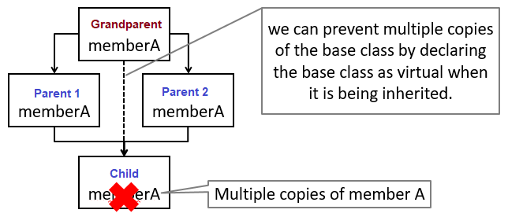
Virtual Base Class
In hybrid inheritance child class has two direct parents which themselves have a common base class.
So, the child class inherits the grandparent via two separate paths. It is also called as indirect parent class.
All the public and protected members of grandparent are inherited twice into child.
Virtual base class is used to prevent the duplication / ambiguity by making common base class as virtual base class while declaring the direct or intermediate base classes.
Multipath inheritance

Slide 41
Example: Virtual Base Class
class base
{
public:
int i;
};
// Inherit base as virtual
class D1 : virtual public base
{
public:
int j;
};
class D2 : public virtual base
{
public:
int k;
};
// Here, D3 inherits both D1 and D2
//However, only one copy of base is present
class D3 : public D1, public D2
{
public:
int product()
{
return (i*j*k);
}
};
int main()
{
D3 obj1;
obj1.i = 10;
obj1.j = 20;
obj1.k = 30;
cout<<obj1.product();
return 0;
}
Output:
6000

Slide 42
References
Reference Books:
Herbert Schildt, ‘C++ The Complete Reference’, Fourth Edition, McGraw Hill Professional, 2011, ISBN-13: 978-0072226805
Robert Lafore, ‘Object-Oriented Programming in C++’, Fourth Edition, Sams Publishing, ISBN: 0672323087, ISBN-13: 978-8131722824
Bjarne Stroustrup, ‘The C++ Programming language’, Third Edition, Pearson Education. ISBN: 9788131705216
K. R. Venugopal, Rajkumar Buyya, T. Ravishankar, ‘Mastering C++’, Tata McGraw-Hill, ISBN 13: 9780074634547
Weblinks:
http://nptel.ac.in/syllabus/106106110/
http://ocw.mit.edu
http://ramperi.org/operatorff.htm
MOOCs:
https://www.coursera.org/learn/c-plus-plus-a
https://www.mooc-list.com/tags/c-1

Slide 43
Summary
Inheritance is the mechanism that provides the power of reusability and extendibility.
Polymorphism makes systems extensible and maintainable.
With single inheritance, a class derived from one base class. With multiple inheritance, a class is derived from more than one direct base class.
A derived class is more specific than its base class and represents a smaller group of objects.
Every object of a derived class is also an object of that class’s base class. However, a base-class object is not an object of that class’s derived classes.
A derived class cannot access the private members of its base class directly; allowing this would violate the encapsulation of the base class. A derived class can, however, access the public and protected members of its base class directly.

Slide 44
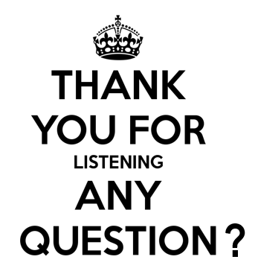

Slide 45
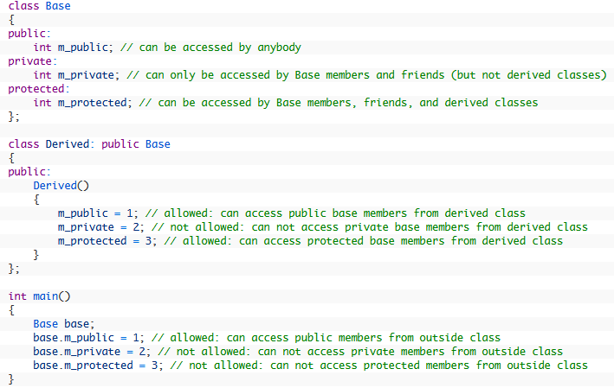

Slide 46
